Slide 1
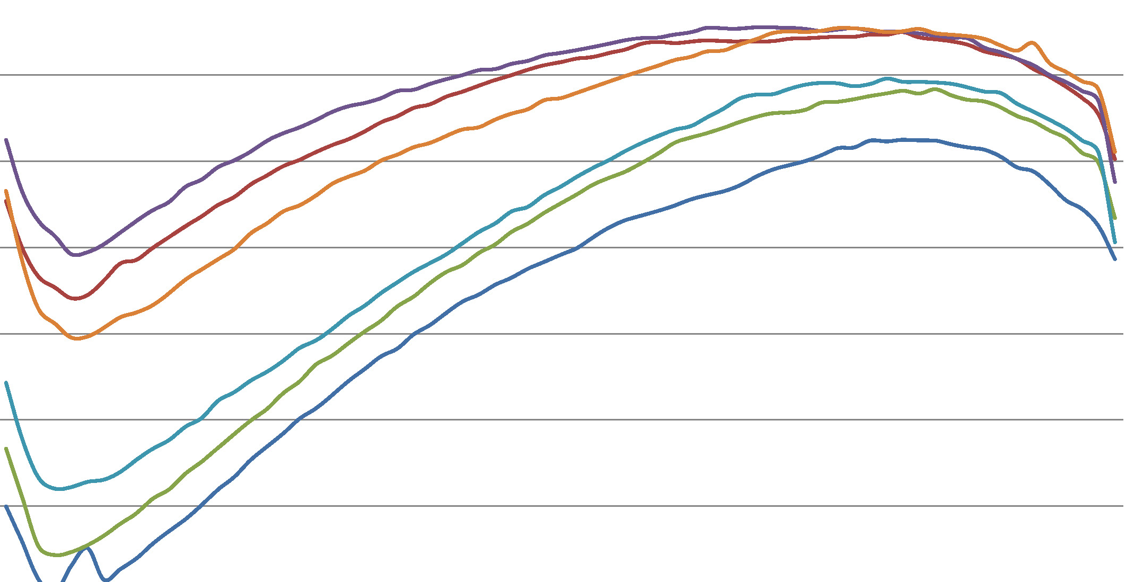
Voter Registration and Participation
Paul MitchelL
Vice President – Political Data Inc.

Slide 2
The 2014 Election
Participation in the 2014 Elections was below all expectations
  2014 Primary
  :: 25% Total Turnout – Gov Primary usually ~ 35%
  2014 General
  :: 42% Total Turnout – Gov General usually ~ 52%

Slide 4
Age as a key factor in voting
Who votes is very strongly associated with age
  Looking at Registered Voters there is a strong historic pattern
  High and low turnout elections generally follow same patterns
  2014 showed strong drop for everyone under 60.

Slide 6
Los Angeles and Rest of State
Different voting patterns historically
  Significantly lower turnout 31% for LA / 46% for rest of state
  Latino 23% to 31% Statewide; Asian 26% to 42%
  Reduced vote turnout exists across age groups

Slide 8
Ethnicity and voting
Hard to overstate the power of ethnicity in voting behavior
  Dramatic differences between the population as a whole and those who vote – making for an Electorate that does not look like California.
  Several Los Angeles Communities are Majority Latino but in low turnout elections the median voter is White
  Latinos have only twice, in thousands of elections studied, significantly outpaced their rate of registration.

Slide 13
Absentee Voting Trends
Rates of Permanent Absentee Status have been increasing.
  2002
  :: 9% of Voters are PAV
  :: 15% of Votes cast are By Mail
  2014
  :: 50% of Voters are PAV
  :: 62% of Votes cast are By Mail

Slide 14
Absentee Voting Trends
Rates of Permanent Absentee Growth has been uneven.
  LA County
  :: 31% of Voters are PAV // 44% of Votes cast are By Mail
  SF Bay
  :: 60% of Voters are PAV // 69% of Votes cast are By Mail

Slide 15
Absentee Voting Trends
Rates of Permanent Absentee Growth has been uneven.
  Divergence in PAV use by Ethnicity
  :: African American 30%
  :: Latino 40%
  :: Asian 55%
  :: White 52%

Slide 16
Absentee Voting Trends
Rates of Permanent Absentee Growth has been uneven.
  New Registrants are becoming more PAV
  :: 49% of Traditional paper registration forms
  :: 60% of Motor Voter paper forms
  :: 66% of Online Voter Registrations

Slide 17
Absentee Voting Trends
Rates of Permanent Absentee Growth has been uneven.
  Age a significant factor, but Closing
  :: 2002: 25% of Age 60+ Ballots / 8% of Age 18-28
  :: 2014: 68% of Age 60+ Ballots / 60% of Age 18-28

