Slide 1
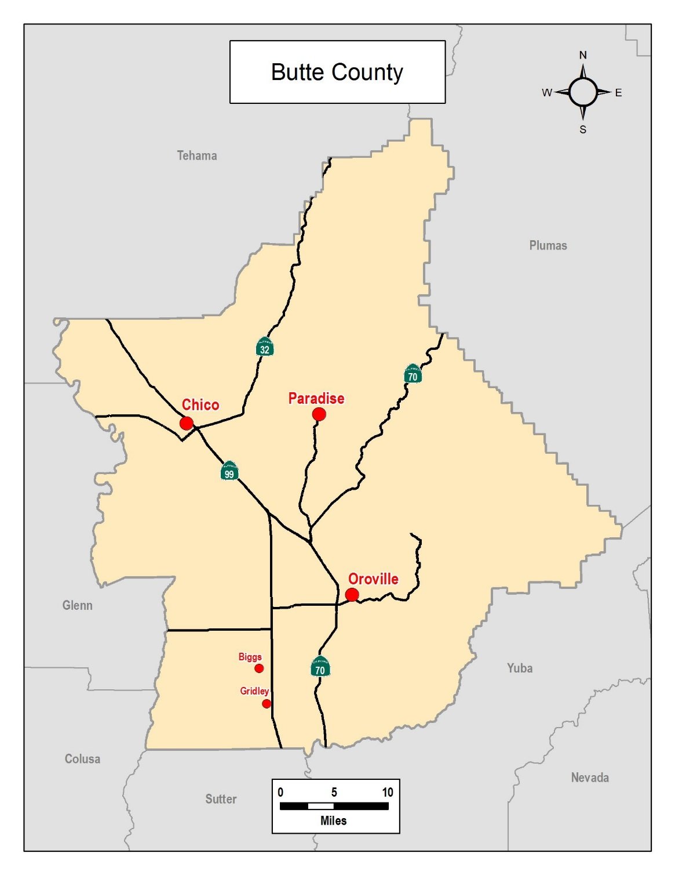
Candace Grubbs, Butte County Clerk-Recorder/Registrar of Voters

Slide 2
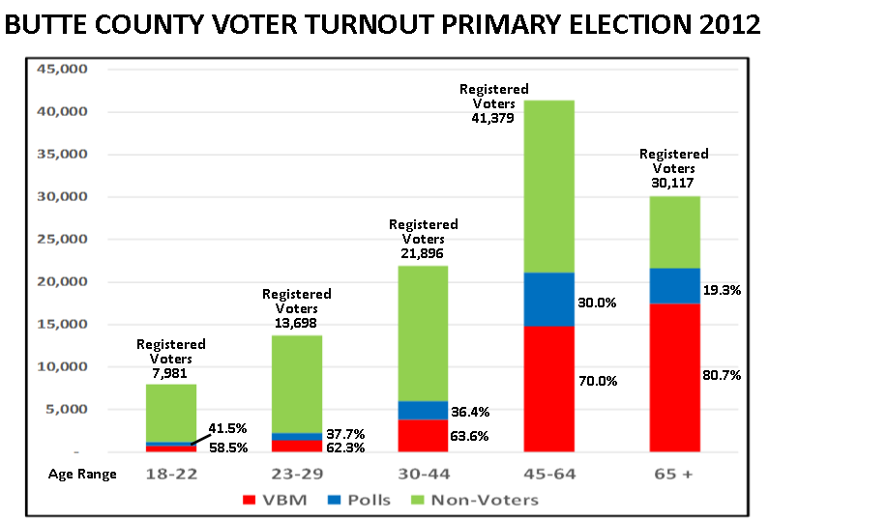
BUTTE COUNTY
VOTER TURNOUT PRIMARY ELECTION 2012 - BY AGE GROUP

Slide 3
BUTTE COUNTY
BUTTE COUNTY VOTER TURNOUT GENERAL ELECTION 2012
VOTER TURNOUT GENERAL ELECTION 2012 - BY AGE GROUP
Registered
Voters
42,815
Registered
Voters
29,738
Registered
Voters
23,641
37.2%
Registered
Voters
15,085
22.7%
Registered
Voters
11,771
46.7%
77.3%
53.2%
62.8%
63.0%
37.0%
46.7%
53.4%
Age Range

Slide 4
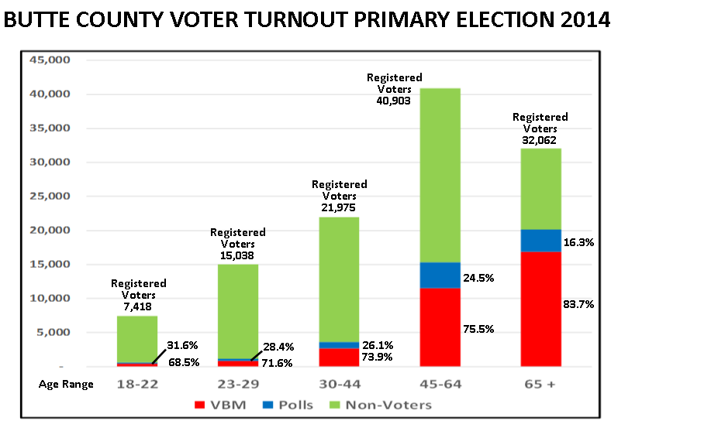
BUTTE COUNTY
VOTER TURNOUT PRIMARY ELECTION 2014 - BY AGE GROUP

Slide 5
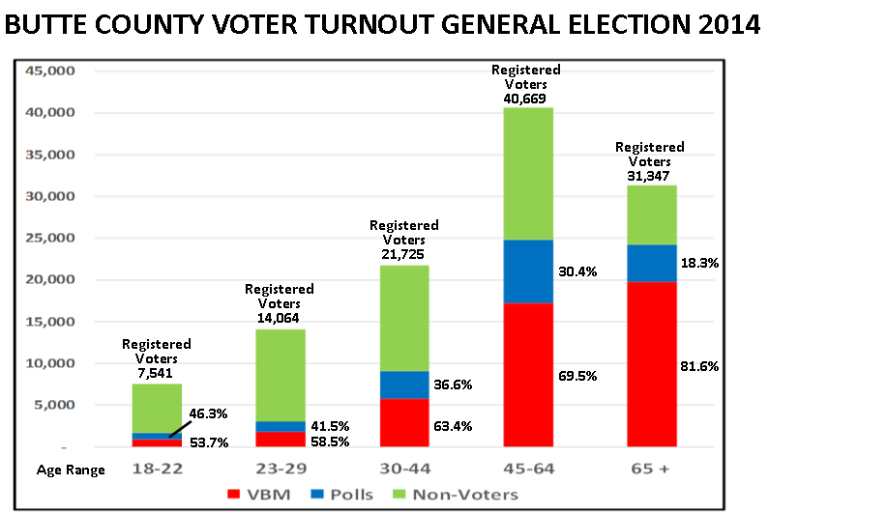
BUTTE COUNTY
VOTER TURNOUT GENERAL ELECTION 2014 - BY AGE GROUP

